Slide 1
Fractions
Decimals
Measurement
Numbers &
Operations
Volume &
2D Figures
100
100
100
100
100
200
200
200
200
200
300
300
300
300
300
400
400
400
400
400
500
500
500
500
500

Slide 2
Write the difference in lowest terms. $3\frac{1}{6}$ - $1\frac{3}{4}$

Slide 3
$$1\frac{5}{12}$$

Slide 4
Nana wants to paint her bedroom walls light blue. She will mix white and blue paint to get the shade she wants. Which expression has the same value as a mixture of $\frac{3}{8}$ gallon blue paint with $\frac{1}{2}$ gallon white paint? Circle all that apply. A) $\frac{5}{8}$ + $\frac{1}{4}$ B) $\frac{3}{4}$ + $\frac{1}{8}$ C) $\frac{1}{8}$ + $\frac{5}{8}$ D) $\frac{1}{4}$ + $\frac{1}{8}$ E) $\frac{3}{8}$ + $\frac{1}{2}$ F) $\frac{3}{8}$ + $\frac{4}{24}$ G) $\frac{5}{8}$ + $\frac{4}{16}$ H) $\frac{3}{4}$ + $\frac{6}{12}$

Slide 5
A) $\frac{5}{8}$ + $\frac{1}{4}$ B) $\frac{3}{4}$ + $\frac{1}{8}$ C) $\frac{1}{8}$ + $\frac{5}{8}$ D) $\frac{1}{4}$ + $\frac{1}{8}$ E) $\frac{3}{8}$ + $\frac{1}{2}$ F) $\frac{3}{8}$ + $\frac{4}{24}$ G) $\frac{5}{8}$ + $\frac{4}{16}$ H) $\frac{3}{4}$ + $\frac{6}{12}$

Slide 6
Elly has 3 pounds of turkey to make 12 sandwiches. She puts the same amount of turkey on each sandwich. Select true of false for each statement. 1) Each sandwhich has more than 1 pound of turkey. 2) Each sandwich has 12 ÷ 3 pounds of turkey. 3) Elly can put $\frac{1}{4}$ pound of turkey on each sandwich. 4) Elly will have $\frac{1}{2}$ pound of turkey left over.

Slide 7
1) Each sandwhich has more than 1 pound of turkey. False 2) Each sandwich has 12 ÷ 3 pounds of turkey. False 3) Elly can put $\frac{1}{4}$ pound of turkey on each sandwich. True 4) Elly will have $\frac{1}{2}$ pound of turkey left over. False

Slide 8
During basketball practice, Tamika made 24 free throws. Kara made $1\frac{3}{8}$ times as many free throws as Tamika. Rosie made $\frac{5}{6}$ as many free throws as Tamika. How many free throws did each girl make? Write them in order from least to greatest.

Slide 9
Rosie 20 Tamika 24 Kara 33

Slide 10
Eric has $\frac{1}{2}$ of his library book left to read. He wants to finish the book in 4 days. He decides to read the same amount on each of these days. What part of the book will Eric read each day?

Slide 11
$\frac{1}{8}$ of the book each day

Slide 12
James recorded the miles he walked each month in the table below. Which statements are correct? Circle all that apply. 1) James walked 29.53 miles in January and February. 2) James walked 0.44 mile farther in March than in April. 3) James walked 26.33 miles in January and April. 4) James walked 24.4 miles in February and April. 5) James walked 4.69 miles farther in January than in March. 6) James walked 3.4 miles farther in February than in March.
Month | Miles
January | 15.73
February | 14.8
March | 11.04
April | 10.6

Slide 13
1) James walked 29.53 miles in January and February. False 2) James walked 0.44 mile farther in March than in April. True 3) James walked 26.33 miles in January and April. True 4) James walked 24.4 miles in February and April. False 5) James walked 4.69 miles farther in January than in March. True 6) James walked 3.4 miles farther in February than in March. False

Slide 14
Which number is equivalent to 0.15 x 10³? A) 0.015 B) 0.15 C) 15 D) 150

Slide 15
D) 150

Slide 16
Derrick needs to find the area of a large poster. The poster measures 1.3 meters by 1.1 meters. The area of the poster is square meters.

Slide 17
1.43 square meters

Slide 18
Gina saves quarters. She has $17.75 in quarters. How many quarters does she have?

Slide 19
71 quarters

Slide 20
Ester packed 9 boxes inside of a crate. Each box weighed the same amount. If the crate weighed a total of 92.16 kilograms, how much did each box weigh?

Slide 21
10.24 kilograms

Slide 22
Are the measurements equivalent? Write yes or no. 1) 4 pounds = 64 ounces 2) 200 centimeters = 2 meters 3) 2 kilograms = 200 grams 4) 4 liters = 4,000 milliliters 5) 2 tons = 200 pounds

Slide 23
1) 4 pounds = 64 ounces yes 2) 200 centimeters = 2 meters yes 3) 2 kilograms = 200 grams no 4) 4 liters = 4,000 milliliters yes 5) 2 tons = 200 pounds no

Slide 24
Jake runs either 15 kilometers or 8,500 meters each day. He alternates short and long runs. How many meters farther will he run on his two long run days than on his two short run day?

Slide 25
13,000 meters

Slide 26
Mrs. Johnson has 2 kilograms of apples, 0.5 kilogram of pears, and 1,500 grams of bananas. She chops the fruit into small pieces and mixes them together. Then she divides the mixture equally into 4 bowls. The finished fruit mixture has a mass of gram(s), so each bowl holds gram(s) of fruit.

Slide 27
The finished fruit mixture has a mass of 4,000 gram(s), so each bowl holds 1,000 gram(s) of fruit.

Slide 28
Omar is excited about going on a camping trip with his friends. The trip is in 8 days. He is counting down the hours and minutes until the trip. Select the numbers from each set of parentheses to make the statement true. The camping trip will occur in (96, 192, 240) hours or (11520, 4608, 2880) minutes.

Slide 29
The camping trip will occur in (96, 192, 240) hours or (11520, 4608, 2880) minutes.

Slide 30
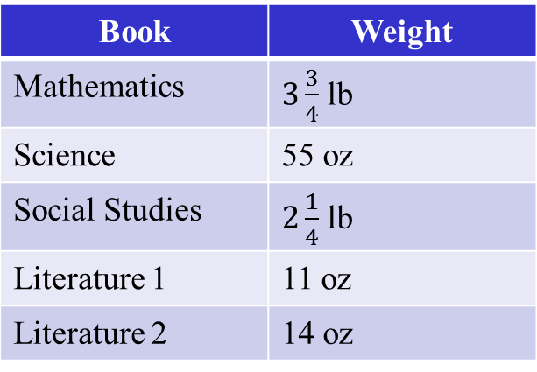
Duane carries all of these books in his backpack. What is the total weight in pounds of the books in Duane’s backpack? What is the total weight in ounces of books in Duane’s backpack?
Book | Weight
Mathematics | $3\frac{3}{4}$ lb
Science | 55 oz
Social Studies | $2\frac{1}{4}$ lb
Literature 1 | 11 oz
Literature 2 | 14 oz

Slide 31
$10\frac{11}{16}$ lbs or 171 oz

Slide 32
A museum gives tours to students in groups of 7. Four fifth-grade classes are going to the museum today. There are 20 students in each class, but three students were absent today. The museum needs to determine the number of tour groups. Select true or false for each statement. A) The expression (5 x 20 – 3) ÷ 7 can be used to find the number of groups. B) The expression (4 x 20 – 3) ÷ 7 can be used to find the number of groups. C) There will be 11 tour groups. D) There will be 77 tour groups.

Slide 33
A) The expression (5 x 20 – 3) ÷ 7 can be used to find the number of groups. False B) The expression (4 x 20 – 3) ÷ 7 can be used to find the number of groups. True C) There will be 11 tour groups. True D) There will be 77 tour groups. False

Slide 34
Which expression shows multiplication as the last operation to be performed? Circle all that apply. A) (3 x 9 + 18 ÷ 6 – 4) x 3 B) (4 + 7) x (17 – 5) ÷ 2 C) 9 x [(11 – 5) ÷ 2 + 4] D) 18 – 27 ÷ 3 + (4 x 5) E) [(6 x 5) – 22 ÷ 11 + 3 – 8] x 10 F) 15 ÷ 3 x 4 – 2 x 6

Slide 35
A) (3 x 9 + 18 ÷ 6 – 4) x 3 B) (4 + 7) x (17 – 5) ÷ 2 C) 9 x [(11 – 5) ÷ 2 + 4] D) 18 – 27 ÷ 3 + (4 x 5) E) [(6 x 5) – 22 ÷ 11 + 3 – 8] x 10 F) 15 ÷ 3 x 4 – 2 x 6

Slide 36
Juan added a set of parentheses and a set of brackets to the expression below. Juan’s expression has a value of 40. 15 ÷ 3 x 5 + 4 x 8 Write one way that Juan could have written the grouping symbols.

Slide 37
[15 ÷ (3 x 5) + 4] x 8

Slide 38
Ryan and Isabella translated the words below into a numerical expression. 5 less than the sum of 4 and 6 Ryan wrote the numerical expression (4 + 6) – 5. Isabella wrote the numerical expression 5 – 4 + 6. Who wrote the expression correctly?

Slide 39
Ryan

Slide 40
Ramon translated a phrase into the numerical expression shown below. 4 x (30 + 60) Which phrase could he have translated? Circle all that apply. A) 4 times 30 plus 60 B) 4 times the sum of 30 and 60 C) add 30 and 60, then multiply by 4 D) 60 more that the product of 4 and 30 E) the sum of 30 and 60 times 4 F) add 30 and 60 to 4

Slide 41
A) 4 times 30 plus 60 B) 4 times the sum of 30 and 60 C) add 30 and 60, then multiply by 4 D) 60 more that the product of 4 and 30 E) the sum of 30 and 60 times 4 F) add 30 and 60 to 4

Slide 42
Write the volume of each rectangular prism.
Rectangular Prism | Number of Unit Cubes in One Layer | Number of Layers | Unit Cube | Volume
A | 4 | 2 | Centimeter
B | 3 | 3 | Inch
C | 2 | 4 | Foot

Slide 43
Rectangular Prism | Number of Unit Cubes in One Layer | Number of Layers | Unit Cube | Volume
A | 4 | 2 | Centimeter | 8 cm³
B | 3 | 3 | Inch | 9 in³
C | 2 | 4 | Foot | 8 ft³

Slide 44
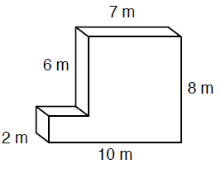
Find the volume of the figure below.

Slide 45
124 m³

Slide 46
A parallelogram has two sets of parallel sides. Circle each quadrilateral that is always a parallelogram. A) Kite B) Rectangle C) Rhombus D) Square E) Trapezoid

Slide 47
A) Kite B) Rectangle C) Rhombus D) Square E) Trapezoid

Slide 48
Circle each true statement. A) All squares are rectangles. B) All rectangles are squares. C) All rhombuses are squares. D) All trapezoids are parallelograms. E) All rectangles are parallelograms.

Slide 49
A) All squares are rectangles. B) All rectangles are squares. C) All rhombuses are squares. D) All trapezoids are parallelograms. E) All rectangles are parallelograms.

Slide 50
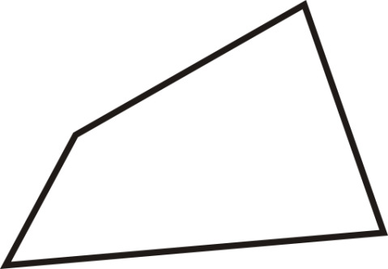
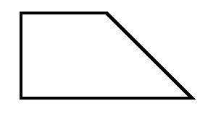
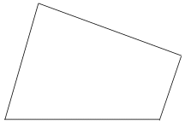
R S T V W
Write yes or no for each statement about the figures.
Figure V and Figure R are trapezoids.
Figure W is not a parallelogram.
Figure S and Figure T are rectangles.
All of the figures are quadrilaterals.
None of the figures is a rhombus.

Slide 51
A. Figure V and Figure R are trapezoids. Yes B. Figure W is not a parallelogram. Yes C. Figure S and Figure T are rectangles. No D. All of the figures are quadrilaterals. Yes E. None of the figures is a rhombus. No

